Slide 1
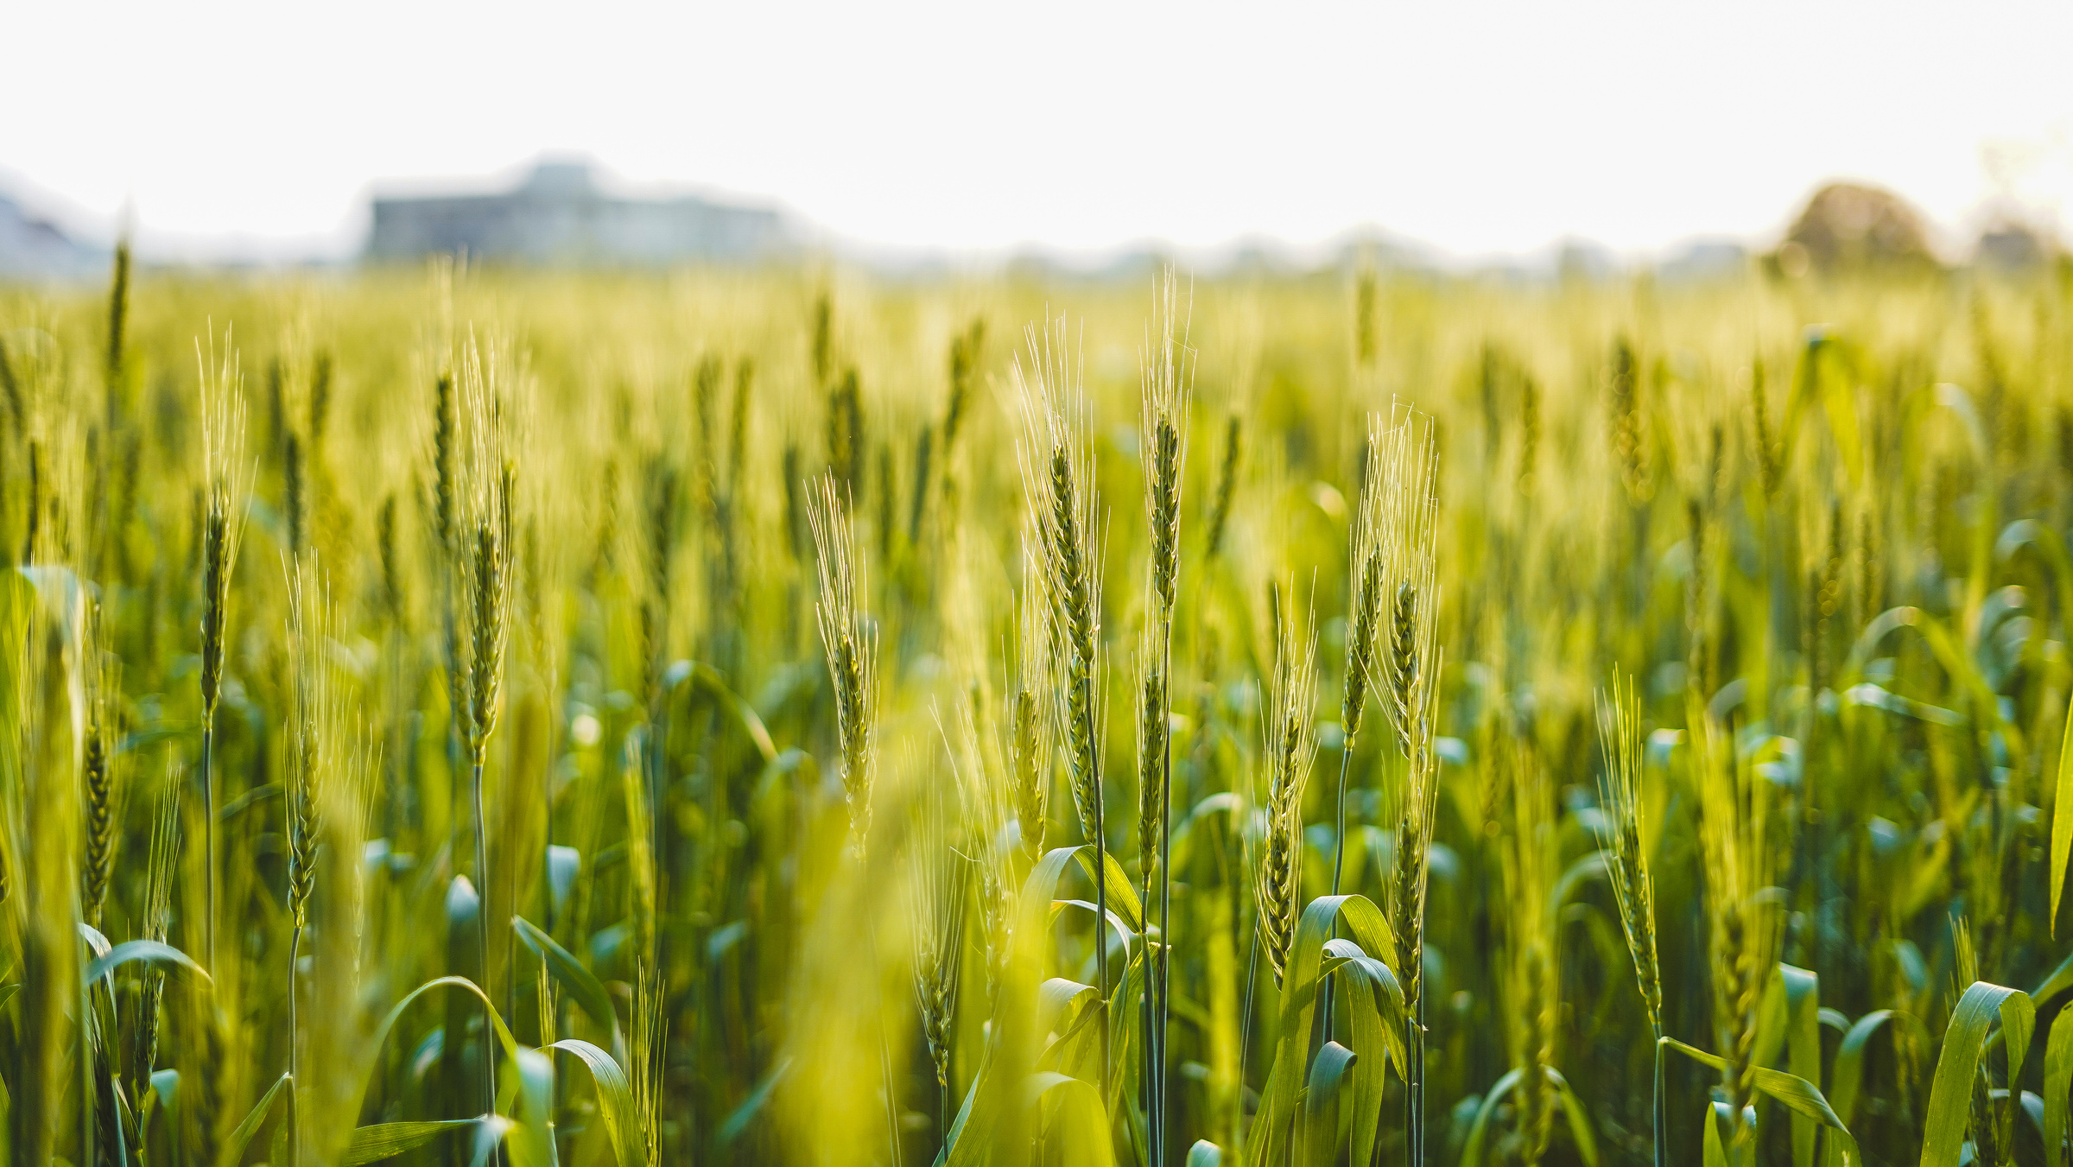



Business
Name
Sustainable Development
Goal Progress
SDG Progress
Report 2025
Presented By
Khateeja Kapoor
Date of
the Report

Slide 2
Report Outline
Introduction
PART 1
PART 2
Message from our Leaders
PART 3
Priority SDGs
PART 4
Measuring Progress
PART 5
Next Steps
Your Business
Name Here
SDG Progress
Report 2025
02

Slide 3



















The 17 Sustainable Development Goals
The Sustainable Development Goals (SDGs), also known as Global Goals, are a set of 17 integrated and interrelated goals to end poverty, protect the planet and ensure that humanity enjoys peace and prosperity by 2030.
Reporting on the SDGs is important in communicating to stakeholders the company's commitment to contributing to the Global Goals; claiming accountability and responsibility to take the necessary actions; and measuring progress over time.
13
CLIMATE
CHANGE
Your Business
Name Here
SDG Progress
Report 2025
03

Slide 4
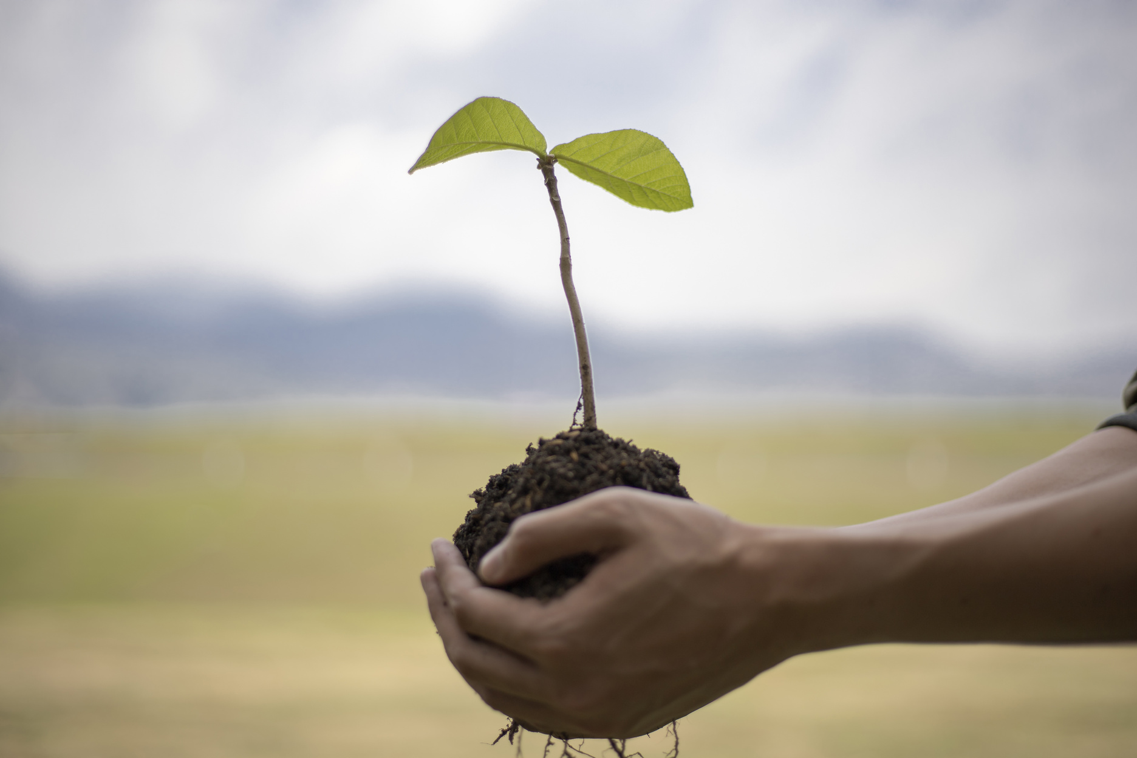
Business
Name
Introduction
Your SDG progress report can start with a brief review of your organisation's alignment to the Global Goals. It can include the social responsibility and business case for taking action on the SDGs.
Creating a good SDG progress report means being transparent with your audience. Back up your claims with relevant data. Keep your sentences concise when necessary, but dive into detail when it comes to qualitative and quantitative evidence.
Your Business
Name Here
SDG Progress
Report 2025
04

Slide 5

Message from
our leaders
This section is an opportunity to demonstrate how top management is taking the lead and giving direction to the company's sustainability efforts.
An authentic, sincere and mission-driven statement from the chair, CEO or president signals commitment and sets the tone for the rest of the report. It can include an overview of the vision, direction and strategy the organisation is committed to take, to help move the needle on the SDGs to meet the global 2030 deadline.
"Catch your reader's eye by highlighting one of your main points in this space."
- Name Here
Your Business
Name Here
SDG Progress
Report 2025
05

Slide 6



Priority SDGs
There are 17 SDGs and 169 targets in total. While they are all important and interrelated, some will be more relevant to your business than others. This section can identify the specific SDGs and targets your organisation is prioritising, and demonstrate how they align with your own business strategy and goals.
PRIORITY SDG
To help give your audience an overview, this section can include a brief description of the goal, its relevance to your sector or industry and the specific sub-targets your organisation is addressing.
PRIORITY SDG
To help give your audience an overview, this section can include a brief description of the goal, its relevance to your sector or industry and the specific sub-targets your organisation is addressing.
PRIORITY SDG
To help give your audience an overview, this section can include a brief description of the goal, its relevance to your sector or industry and the specific sub-targets your organisation is addressing.

Slide 7
Measuring
Progress
Performance goals are a good way to monitor and measure progress. Reporting performance can include details such as indicators identified, data collected and SDG-related activities accomplished.
KEY INDICATOR
ACTIVITY / PROJECT
DATA / OUTCOME
Your Key Performance Indicator goes here
Add a few details describing the related activities
What results did you obtain from your project?
Write them here.
Your Key Performance Indicator goes here
Add a few details describing the related activities
What results did you obtain from your project?
Write them here.
Your Key Performance Indicator goes here
Add a few details describing the related activities
What results did you obtain from your project?
Write them here.
Your Business
Name Here
SDG Progress
Report 2025
07

Slide 8
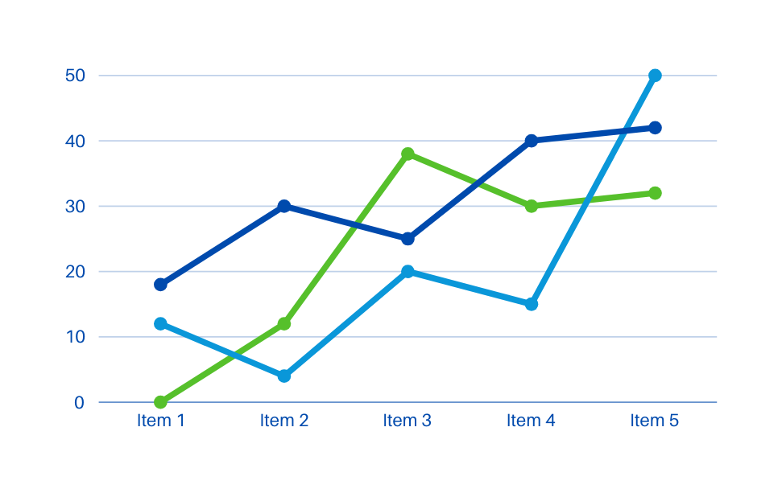
What's your Infographic Title?
Performance goals are a good way to monitor and measure progress. Reporting performance can include details such as indicators identified, data collected and SDG-related activities accomplished.
100
Readers appreciate accurate information
80
Readers appreciate accurate information
Your Business
Name Here
SDG Progress
Report 2025
08

Slide 9
What should you be including in your SDG progress report? While there is no standard way of reporting on the Global Goals as of yet, here are a few methods to consider when presenting your data:
1
KEY STATISTICS
2
KEY FINDINGS
3
REPORT CARDS
your most important quantitative data
qualitative results from SDG-related projects or activities
criteria and grade assessments for transparent reporting
4
INFOGRAPHICS
5
TIMELINES
an organised snapshot of relevant data
a visual way to track progress over time
Catch your reader's eye by highlighting one of your main points in this space.
Your Business
Name Here
SDG Progress
Report 2025
09

Slide 10
Next Steps
This SDG Progress Report is a continuous work in progress - a way for your organisation to track its impact and improvements over time. This section outlines your strategy for continuing the good work done so far.
ACTION OR COMMITMENT
ACTION OR COMMITMENT
ACTION OR COMMITMENT
Include a brief description, rationale and intended impact. It helps to keep it concise yet concrete!
Include a brief description, rationale and intended impact. It helps to keep it concise yet concrete!
Include a brief description, rationale and intended impact. It helps to keep it concise yet concrete!
Your Business
Name Here
SDG Progress
Report 2025
10

Slide 11



Conclusion
End your report with a review of the highlights and a renewed commitment to continue working on making the SDGs attainable by 2030.
A vision statement, call-to-action or quote from your leaders are powerful ways to conclude your progress report. Leave your audience inspired and motivated to help your organisation achieve its SDG-aligned goals!
Summarise the key points here.
Bullet points help!
Bullet points help!
HIGHLIGHT 1
Summarise the key points here.
Bullet points help!
Bullet points help!
HIGHLIGHT 2
Summarise the key points here.
Bullet points help!
Bullet points help!
HIGHLIGHT 3
Your Business
Name Here
SDG Progress
Report 2025
11

Slide 12

Acknowledgements
Most reports conclude with a page acknowledging the contributions of the people who worked tirelessly on the projects mentioned within. Below, list down the names of those committed to these projects, such as:
Those responsible for concept and coordination
Your group of researchers
The writers behind the impact report
The designers of the impact report
Your colleagues from Local and Partner Organisations
Your contributors
Your Business
Name Here
SDG Progress
Report 2025
12

Slide 13
Business
Name
Contact
Your Business Name
123 Anywhere St., Any City, ST 12345
123-456-789
www.reallygreatsite.com
hello@reallygreatsite.com
@reallygreatsite
We thank you for your continued support in our efforts to contribute to the SDGs.

Slide 14
Free
Resource
Page
13
CLIMATE
CHANGE
Use these official Sustainable Development Goal elements in your Canva presentation.

Slide 15

















Free
Resource
Page
Use these official Sustainable Development Goal elements in your Canva presentation.

Slide 16

















Free
Resource
Page
Use these official Sustainable Development Goal elements in your Canva presentation.

